Slide 1

Notes:
Plane flying through

Slide 2


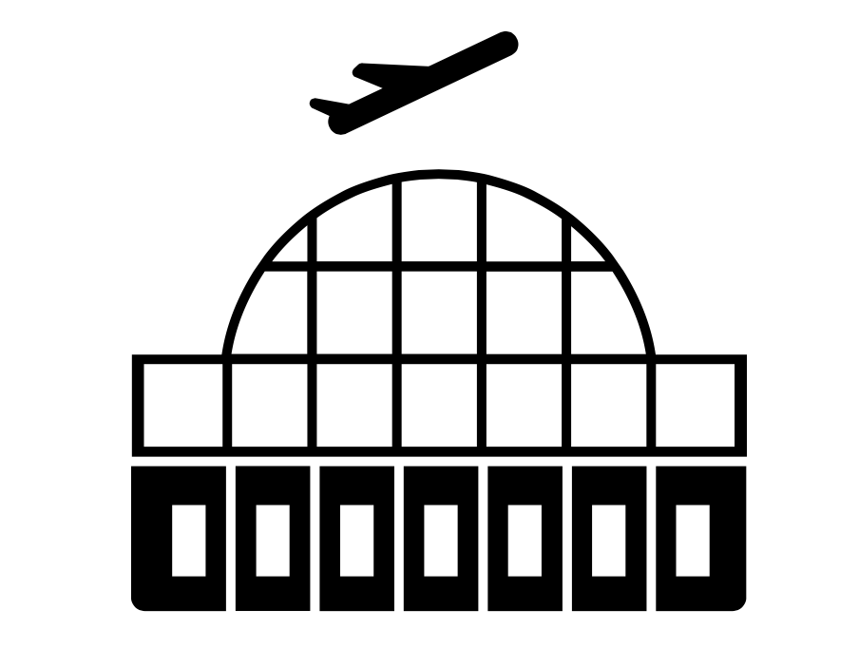


CHICAGO
NEW YORK CITY

Slide 3
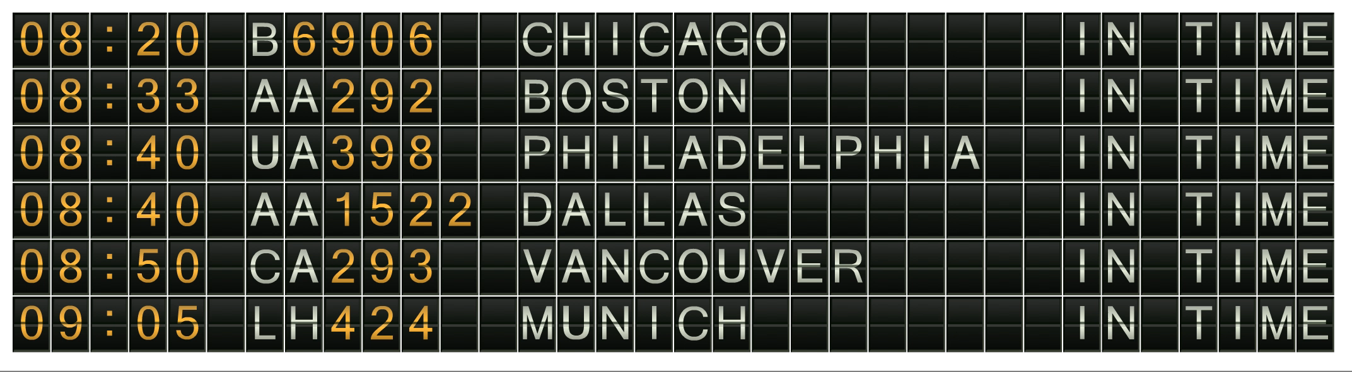


Notes:
Delayed Animation

Slide 4



CHICAGO
NEW YORK CITY

Slide 5







AIRPORT
AIRLINE
WEATHER
TRAFFIC
REPAIRS
Why is my flight delayed?

Slide 6
AIRPORT
AIRLINE
WEATHER
TRAFFIC
REPAIRS

Slide 7
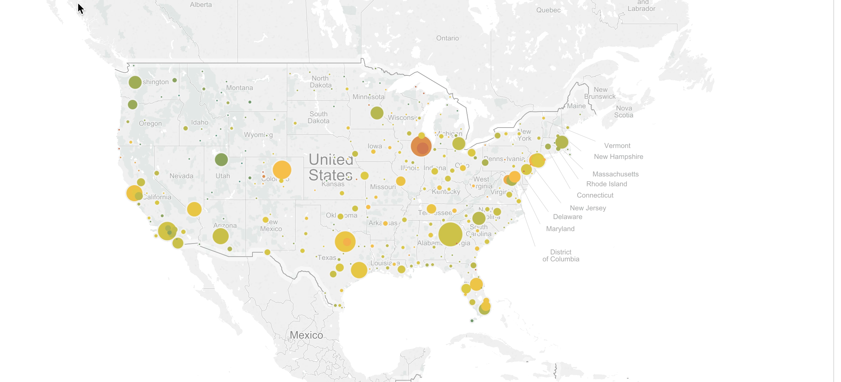

Slide 8
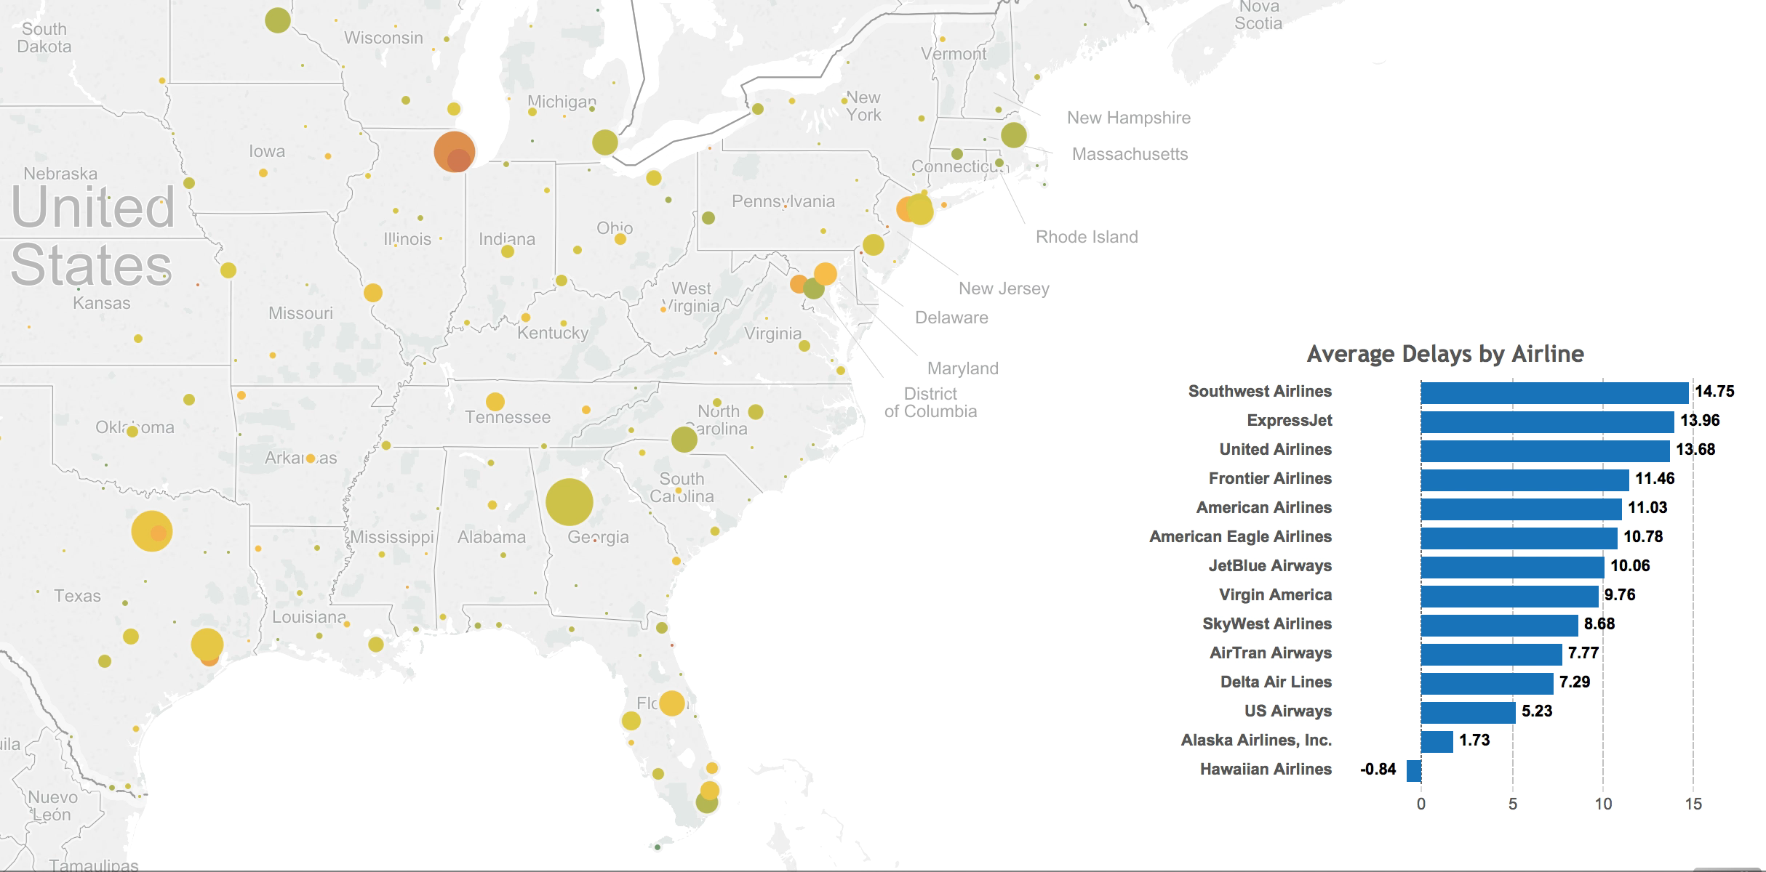

Slide 9
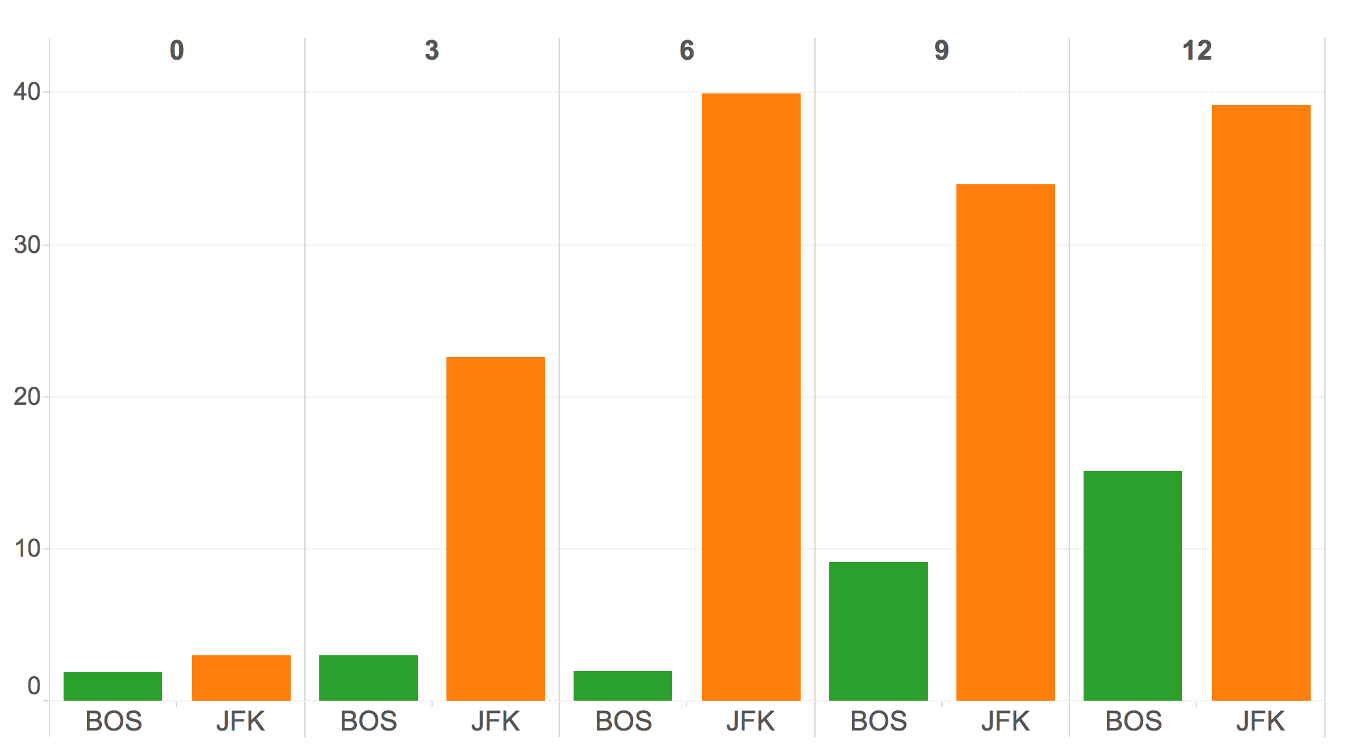
Snow Depth in Inches
Avg.
Weather Delay
(in minutes)

Slide 10
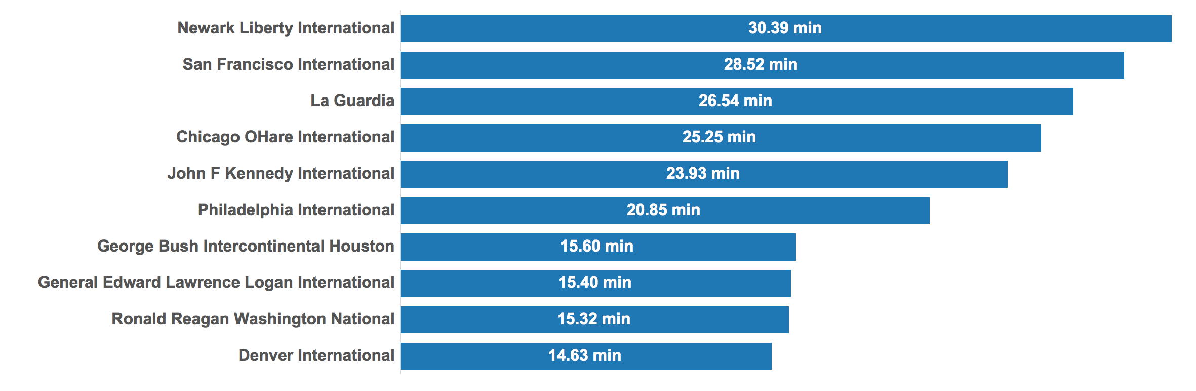

Slide 11
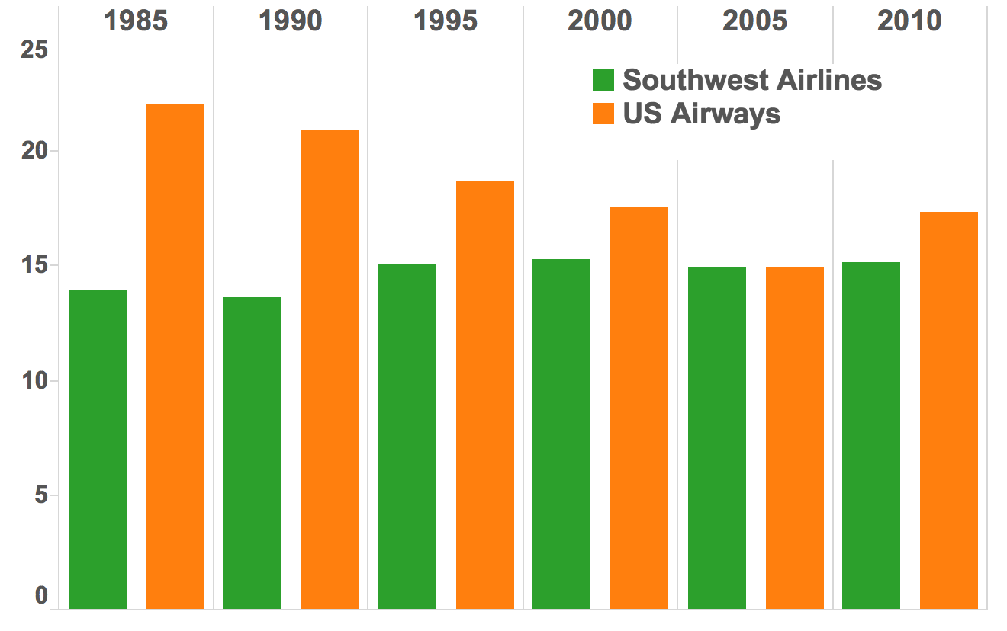
Aircraft Age
Average
Carrier Delay
(in minutes)

Slide 12
Which flight should I choose?

Slide 13


Slide 14
Insert Tableau Airport Analysis Video

